Slide 1
Expess

Slide 2
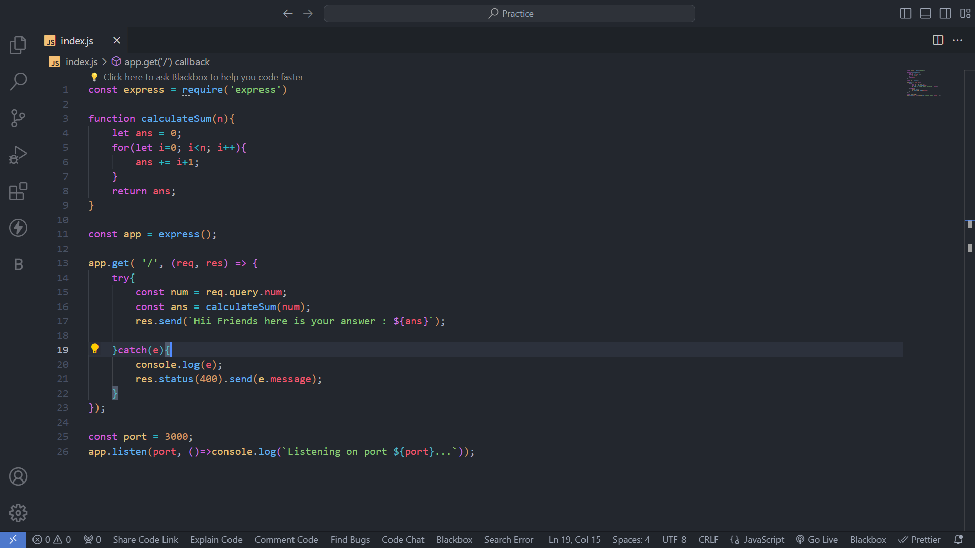

Slide 3
Request Method
GET – Taking an input
POST – Give something like Instagram post (Insertion)
PUT - Update
DELETE - Delete

Slide 4
Status Codes
200 – Everything went fine
404 – Doctor is not in the hospital
500 – Mid surgery light went away
411 – Inputs were incorrect, wrong person came to surgery
403 – You were not allowed in the Hospital.

Slide 5
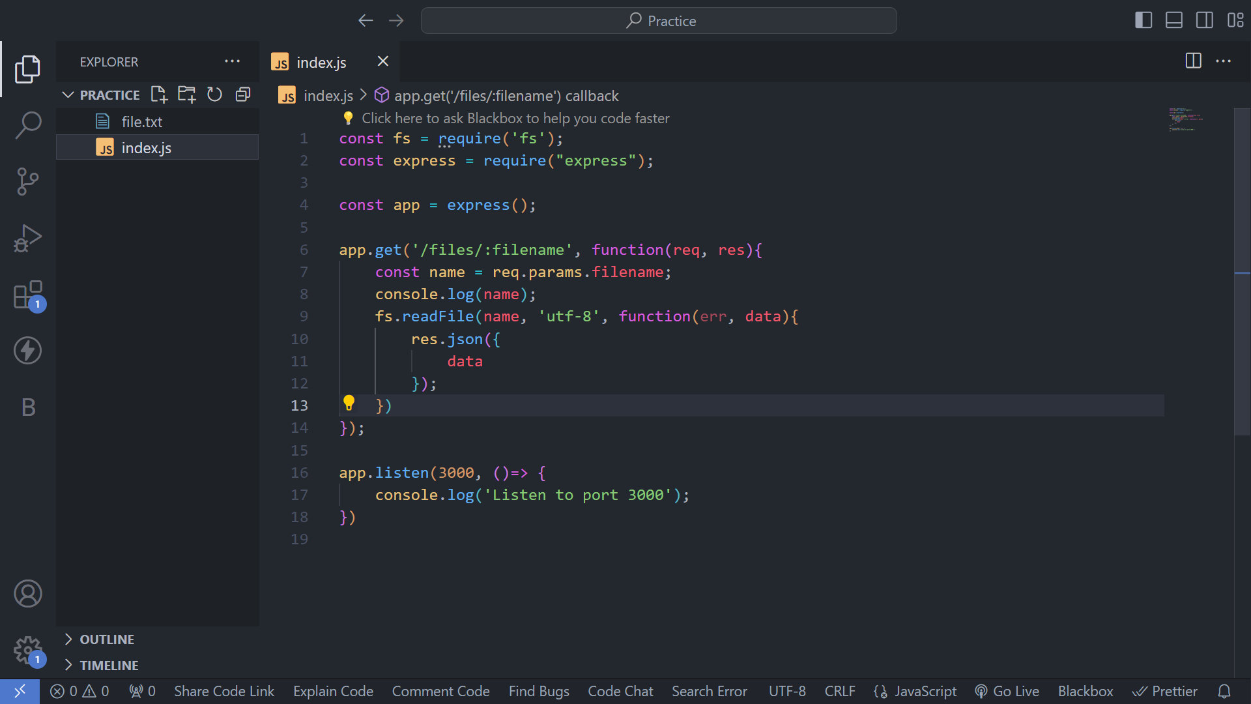

Slide 6
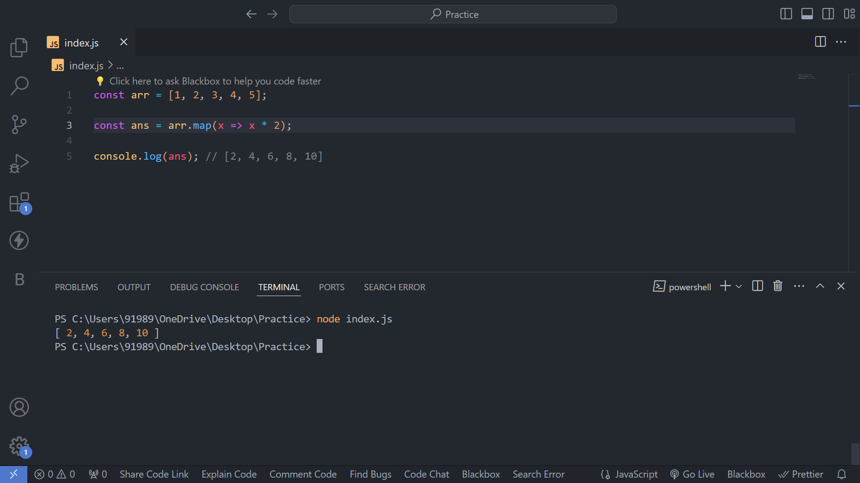
MAP Function

Slide 7
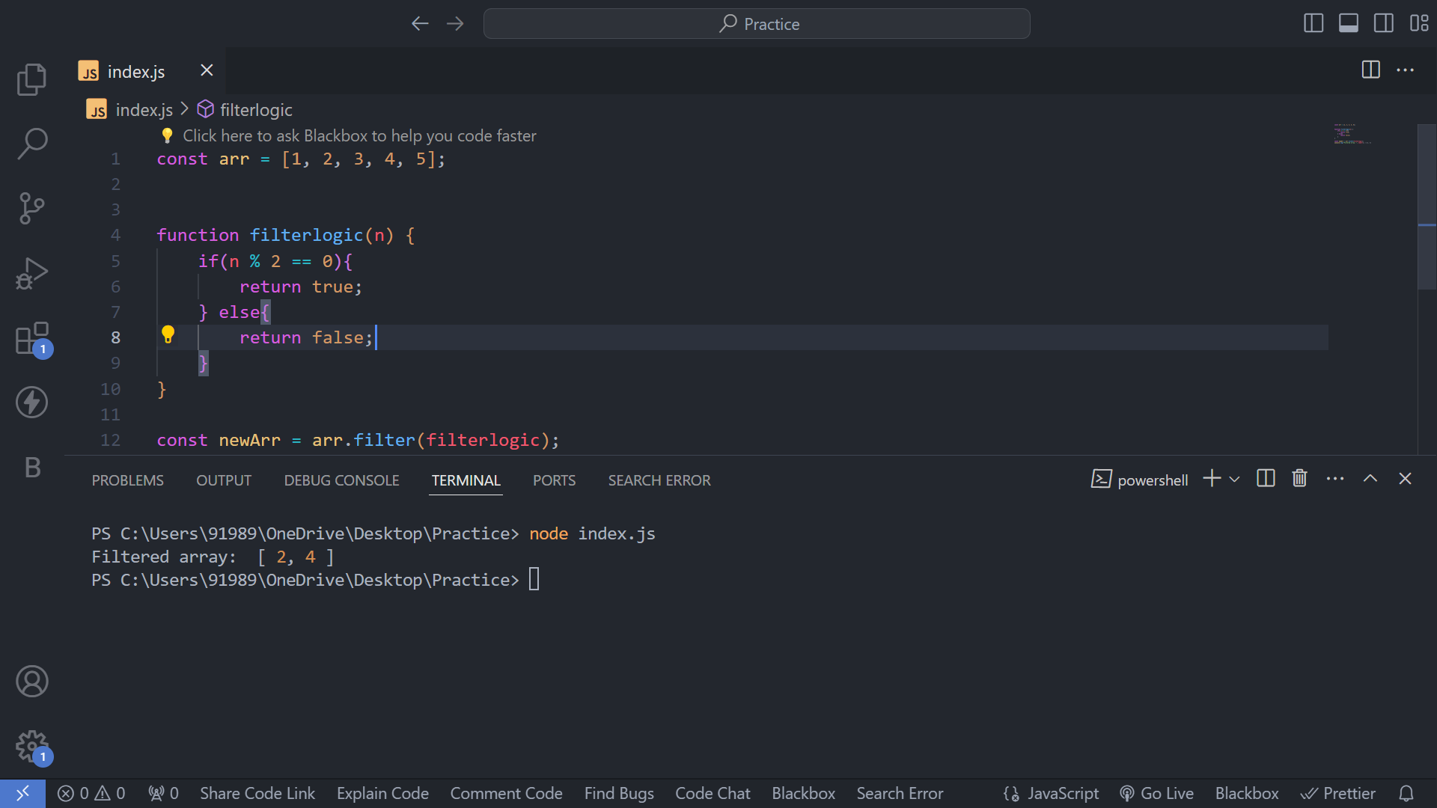
Filter

